Slide 1
Colorado Pollution Levels
A study of air pollution levels in Colorado over time

Slide 2
Statistical Question & Hypothesis
Statistical Question: As a nation, we continue to become more aware of environmental issues like pollution. The government imposes environmental standards to help mitigate pollution and there has been a huge movement in both the public and private sectors, towards clean energy sources like electric, solar, and wind power. But are we making an impact?
Hypothesis: My hypothesis is that pollution levels will decrease over time?

Slide 3
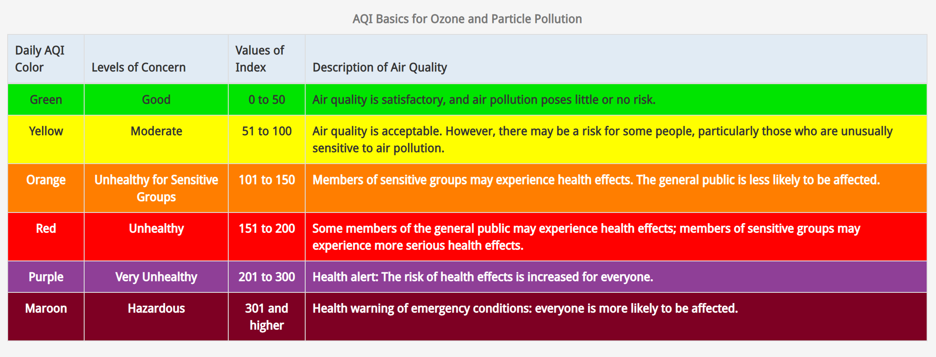
Air Quality Index Measurement
AQI Measurement: U.S. Air Quality Index (AQI) standard measures air pollution rates based on the individual air quality indexes of six factors: ground-level Ozone (0₃), Carbon Monoxide (CO), Sulfur Dioxide (SO₂), Nitrogen Dioxide (NO₂), and particulate matter (PM_{2.5} & PM₁₀).
Figure 1: U.S. AQI Table (AirNow.gov, 2020).

Slide 4
Data Set Contents
Daily Individual AQI measurements of:
Ozone (O3)
Carbon Monoxide (CO)
Sulfur Dioxide (SO2)
Nitrogen Dioxide (NO2)
Highest Daily IAQI
Timeline: 1/1/2003 – 12/31/2010
Retrieved from:

Slide 5
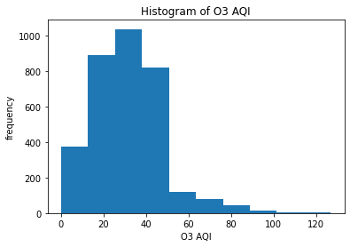
Histogram of Ozone IAQI
Mean: 31.86
Mode: 25
Range: 0-127
IQR: 20-42
Variance: 268.76
Skew: moderate positive skew 0.9
Kurtosis: platykurtic 2.26

Slide 6
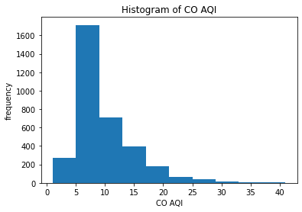
Histogram of Carbon Monoxide IAQI
Mean: 9.16
Mode: 6
Range: 1-41
IQR: 6-11
Variance: 26.76
Skew: high positive skew, 1.77
Kurtosis: leptokurtic, 4.36

Slide 7
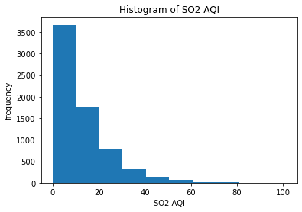
Histogram of Sulfur Dioxide IAQI
Mean: 12.99
Mode: 0
Range: 0-101
IQR: 4-19
Variance: 148.73
Skew: high positive skew, 1.78
Kurtosis: leptokurtic, 4.54

Slide 8
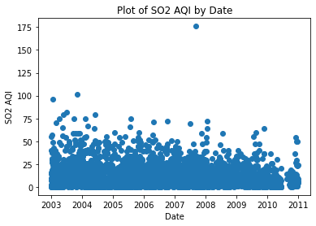
SO2 Outlier
EDA revealed an extreme outlier in the SO2 variable.
Identified by scatterplot and very high kurtosis.
The SO2 value was 176, with the next closest value being 101.
It is unknown what caused the outlier. SO2 AQI is produced by burning of fossil fuels and can be affected by forest fires, but this was only 1 day.
Due to the extreme nature of this value and the possibility that it could degrade the value of the data, I have chosen to remove it.

Slide 9
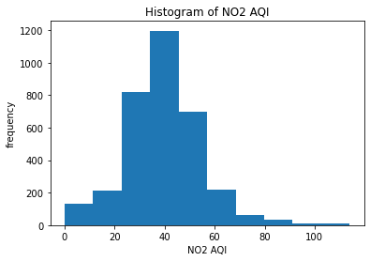
Histogram of Nitrogen Dioxide IAQI
Mean: 39.63
Mode: 42
Range: 0-114
IQR: 31-48
Variance: 224.05
Skew: Symmetrical, 0.46
Kurtosis: platykurtic, 1.8

Slide 10
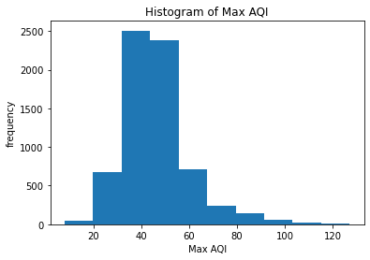
Histogram of Highest Daily IAQI
Mean: 46.06
Mode: 42
Range: 8-127
IQR: 38-51
Variance: 191.38
Skew: high positive skew, 1.3
Kurtosis: leptokurtic, 3.33

Slide 11
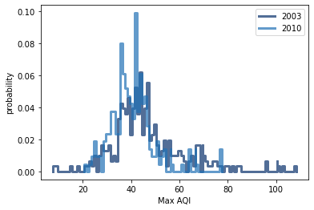
PMF
Max AQI data from 2003 and 2010 to compare the PMFs.

Slide 12
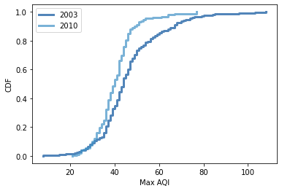
CDF
PMF was difficult to gain insight from, so I used the same values to plot a CDF comparison.
2010 has lower Max AQI scores.
The discrepancy gets considerably larger above the mean. 2003 had NO2 scores that were much higher than 2010.
This indicates that my hypothesis could be correct: Pollution levels have decreased over time.

Slide 13
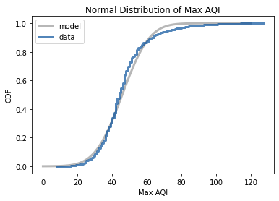
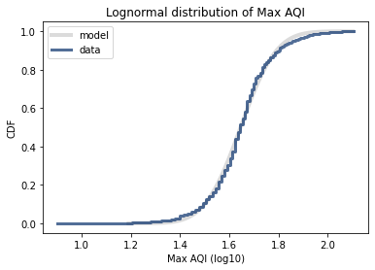
Normal vs Lognormal Distribution
The same distribution is shown on a linear scale and a log scale.
The data fits the lognormal model better.

Slide 14
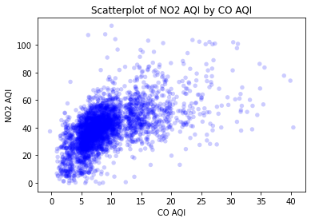
Scatterplot of NO2 AQI by CO AQI
Positive relationship
Covariance: 44.2
Pearson’s Correlation Score: 0.57
Spearman’s Rank Correlation: 0.61
Closeness suggests skewness in distribution explains most the difference between Pearson’s and Spearman’s correlation scores.

Slide 15
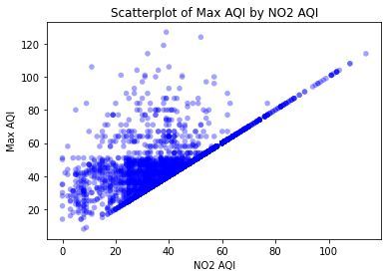
Scatterplot of Max AQI by NO2 AQI
Positive relationship
Covariance: 136.12
Pearson’s Correlation Score: 0.66
Spearman’s Rank Correlation: 0.69
Closeness suggests skewness in distribution explains most the difference between Pearson’s and Spearman’s correlation scores.
Causation: Max AQI is the highest scoring daily AQI. NO2 is often the highest scoring, therefore NO2 can be considered to have a certain amount of causality on Max AQI.

Slide 16
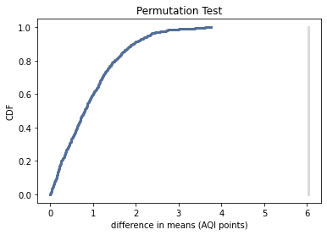
Hypothesis Test
Used permutation to test the difference in means between Max AQI in 2003 and Max AQI in 2010. The calculated difference in means was 6.03 points.
Results:
After 1000 attempts, the simulation never yields an effect as big as the observed difference of 6.03.
P < 0.001, the difference in Max AQI scores is statistically significant and the null hypothesis is rejected.

Slide 17
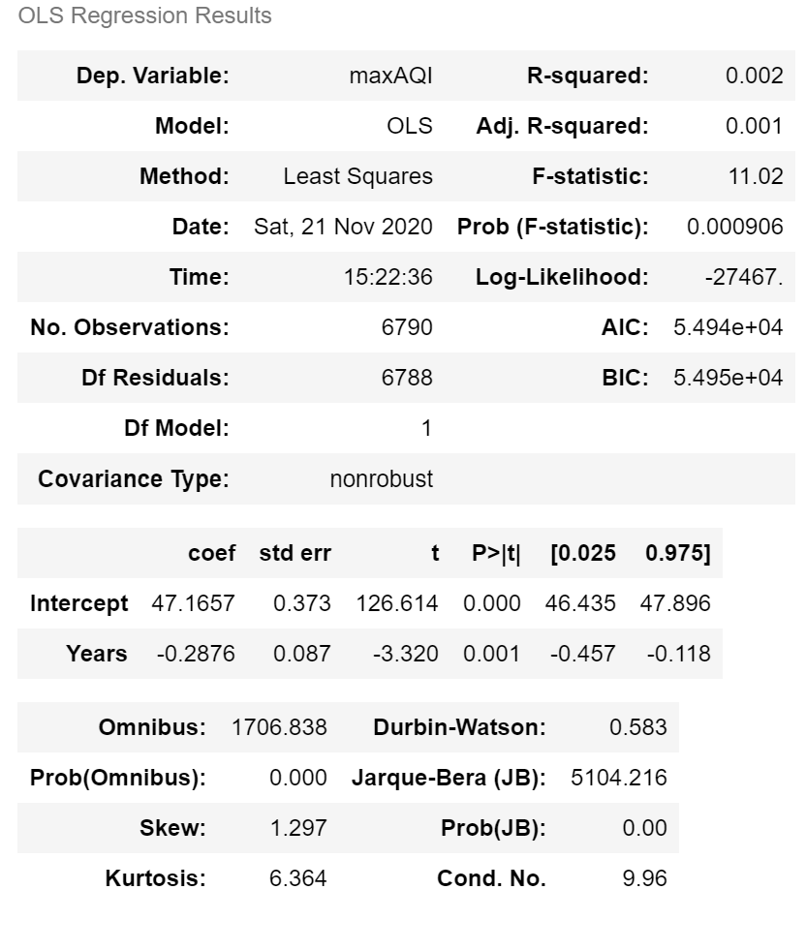
Regression Analysis
Linear regression results - Max AQI by Year:
Intercept: 47.166
Slope: -0.288
R2: 0.002
Meaning:
Mean Max AQI decreases by 0.288 points per year
R2 of 0.002 indicates year is only accountable for 0.2% of observed variability in Max AQI

Slide 18
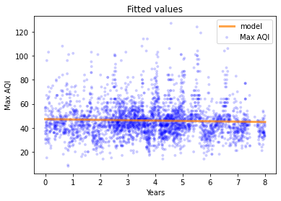
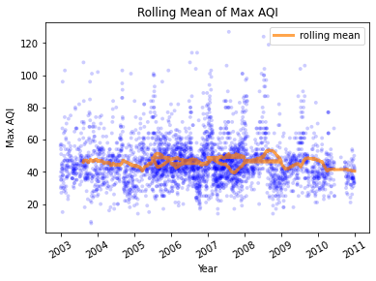
Regression Analysis
Due to time not commonly producing linear data, I also plotted the annual rolling mean

Slide 19
References
AirNow.gov. (n.d.). AQI Basics. AirNow.gov. Retrieved from https://www.airnow.gov/aqi/aqi-basics/#:~:text=Think%20of%20the%20AQI%20as,300%20represents%20hazardous%20air%20quality.
So, B. (2016, November 4). U.S. Pollution Data: Pollution in the U.S. Since 2000, Version 1. Retrieved September 27, 2020 from https://www.kaggle.com/sogun3/uspollution.

